Slide 1

Travel Diary
Ying Wang
Shaobin Ding
Congrui Xu
Tong Liu

Slide 2


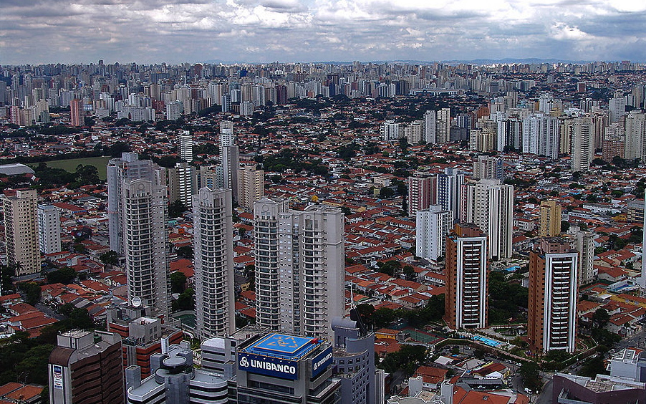
Introdution
long term heavy load
Humdrum living environmet

Slide 3
Introdution(Cont.）
Trip-trip aims at helping people to:
Keep minute of life
Relax yourself
Make friends during trip
Ideal website for you!

Slide 4

Functions
Basic:
Account management
Add friends or groups
Basic search
Share information
Comments

Slide 5
Functions(Cont.)
Advanced:
Rank
Recommendation
Chat
Advanced search

Slide 6
Main Page Design
Basic:
Easy for user
Make more fun
Share the happyness

Slide 7

Regi Page
Use HTML5
More new features to be used

Slide 8
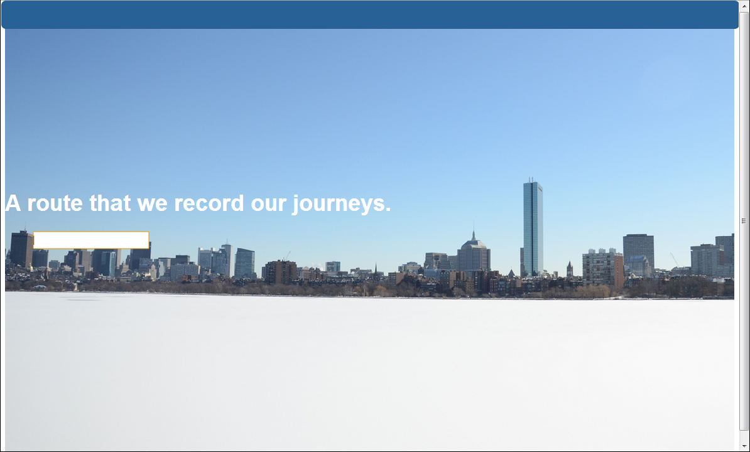
WebHome

Slide 9
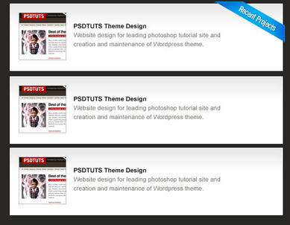
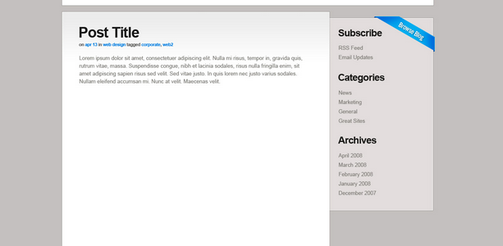
Personal page
Make record for your own
Share with your friends

Slide 10

Website Hierarchy(basic)
Register
Welcome Page
Login
Profile
Scenery Page
Personal Page
Activity
Search
experience
Specific Scenery
location
food
expense
accommodation

Slide 11
Website Hierarchy(Advanced)
Register
Welcome Page
Login
Profile
Scenery Page
Personal Page
Chat
Plan
Activity
access
Recommendation
Rank
Advanced Search
Search
Rate
experience
Specific Scenery
CTR
location
food
expense
accommodation

Slide 12
Milestone
1. Design Main pages of website
2. Gather contents to enrich database
3. login function and friends function.
(Design database for user information)
4. Design personal page
5. Design database for travel blog function
6. Comment function, thumb up or thumb down
7. UI beautification
8. Advanced Features
9. Testing

Slide 13
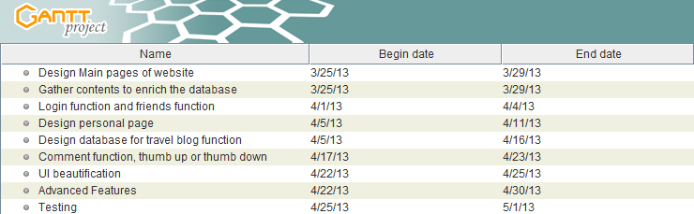
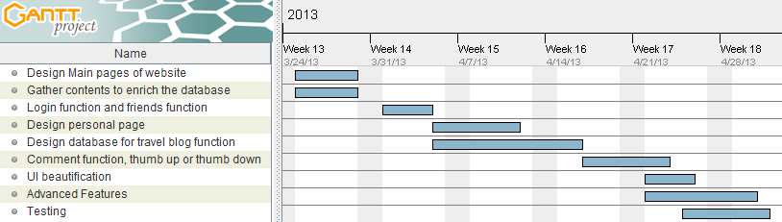
Gannt Chart

Slide 14
Work Division
Ying Wang
User interface design and implementation.
Gather information for the contents and enrich the database.
Congrui Xu
Login function and friends function.
Testing
Tong Liu
Design and maintain the database for user imformation
Design databse for travel blog and photos
Shaobin Ding
Progaming for main page and personal pages
Design the structure of travel blog
Comment function

Slide 15
Risk Analysis
1 Trip plan function
2 Recommendation function
3 Dynamic news update

Slide 16

Thank you!

